Slide 1
Introduction to Azure IoT Suite

Slide 2
Pre-Class Activities
Connect your laptop to ssid: xxx
Note: Please help us save bandwidth for the class by DO NOT CONNECT your phone to wireless
Download Class resources xxx Extract files and review class content
Get Azure Pass from Instructor

Slide 3
Class Objective
Understanding Microsoft IoT, IoT Suite and Related Components
Ability to provides customer consultant on component requirement to implement IoT Solution
Ability to conduct Proof-Of-Concept of Azure IoT
Ability to leverage Azure IoT Preconfigured Solutions
Pass Requirements Check-Point / Examination

Slide 4
Agenda
Introduction to Microsoft Azure IoT Suite (60 minutes)
Break
HOL: Getting Start with Simulated Device & Azure IoT Hub (60 minutes)
Lunch
HOL: Getting Start with Azure Stream Analytics (60 minutes)
HOL: Connecting Azure Stream Analytics data to PowerBI (45 minutes)
Break
HOL: Introduction to Microsoft Azure Big Data Platform (60 minutes)
Introduction to IoT Preconfigured Solutions (60 minutes)

Slide 5
Connected Devices 2010
Alarm clock
Refrigerator
Automobile
VoIP phone
Computer
Printer
Media player
Microwave
HOME
WORKPLACE
HOME
Coffee maker
Smart scale
Oven
Cell phone
HVAC
Vending
Security
Television

Slide 6
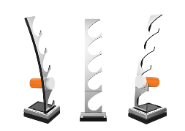
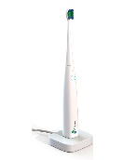

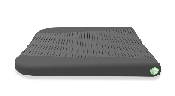
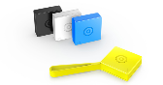
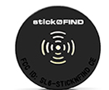


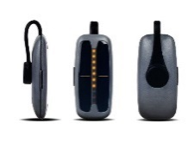

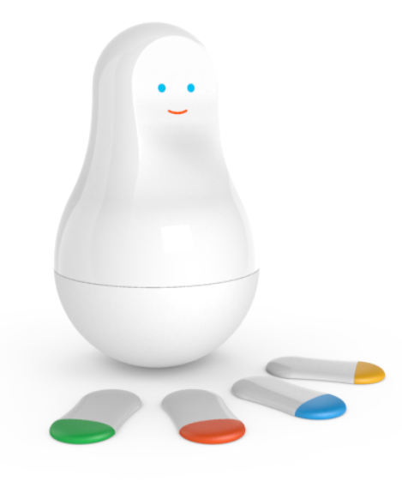
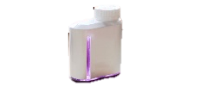

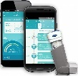
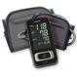

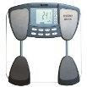
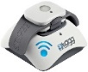
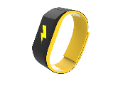
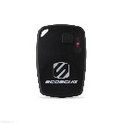


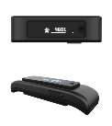



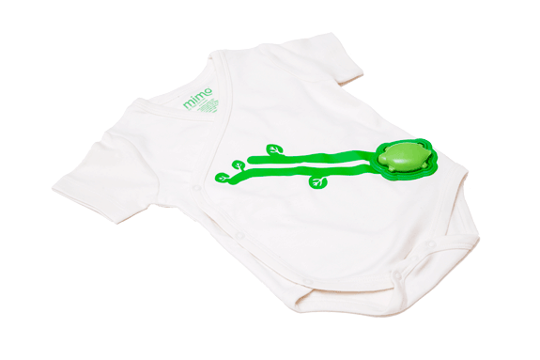
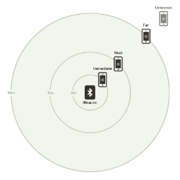
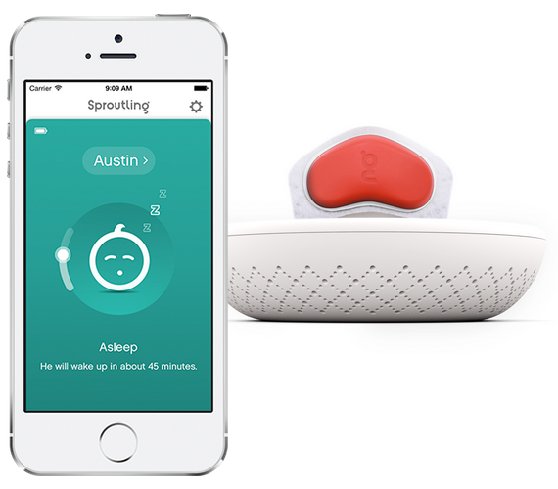

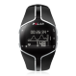
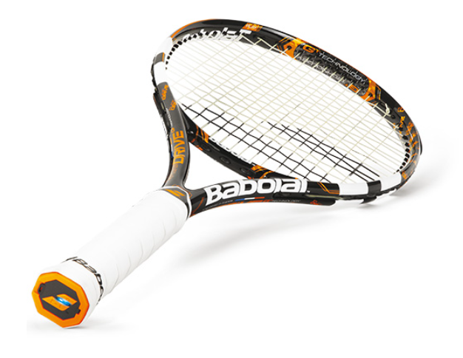

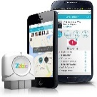
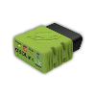

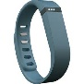
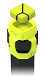
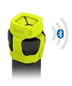
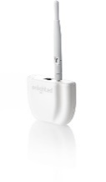
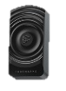


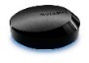
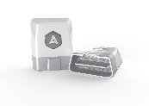
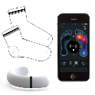
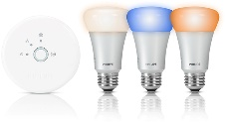
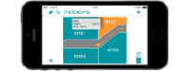
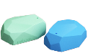
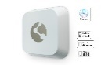

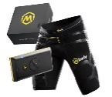
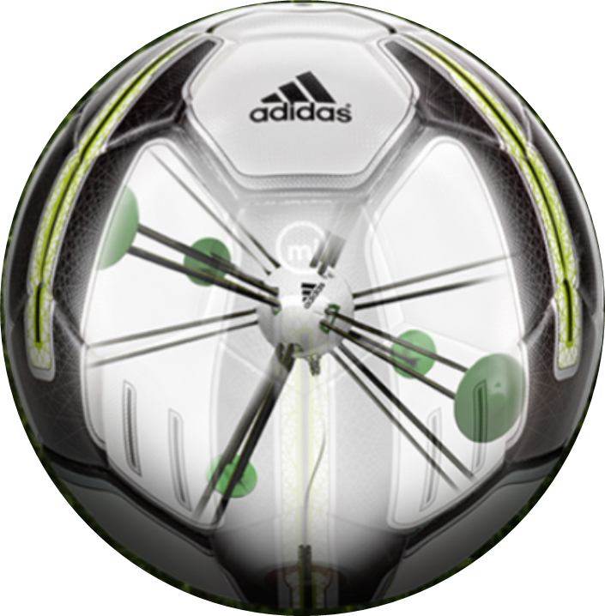


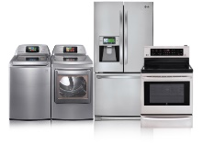
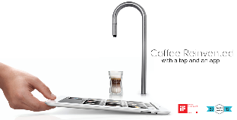
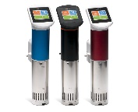
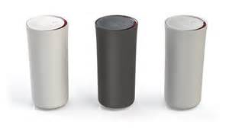
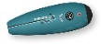
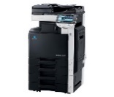
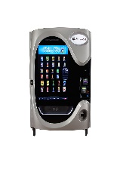
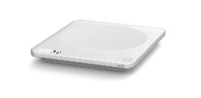

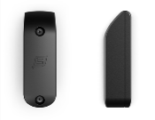
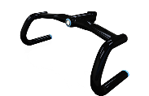
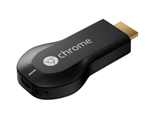
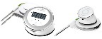
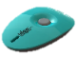

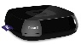
































Connected Devices 2015
Medication adherence
Health monitoring
Pet tracking
Behavior modification
Object tracking
Child and elder monitoring
Sports and fitness
Indoor navigation
Trip tracking and car health
Smart lighting
Beacons and proximity
COMMUTE
COMMUTE
HOME
WORKPLACE
HOME
Smart appliances
Food and nutrition tracking
Identity
Office equipment
Smart vending machines
Bike ride stats and protection
Air conditioning and temperature control
Sleep tracking
Environmental sensors
Information capture
Control
Home security
Home automation
Leak detection
Garden, lawn and plant care
New devices and sensors
Entertainment systems

Slide 7
Internet of Things opportunity
25 billion Connected “things” by 2020
—Gartner
70%
of value enabled by IoT will come from B2B scenarios
McKinsey & Company
$1.7 trillion
Market for IoT by 2020
—IDC
Notes:
Talking Points:
You’ve probably have heard a lot about IoT.
There’s a lot of noise out there and there are number of companies talking about IoT.
There are big numbers being thrown around.
According to latest IDC’s report, the IoT market is expected to be $1.7 trillion by 2020
Gartner predicts that there will be over $25 Billion connected “things” by 2020..
There is so much hype around IoT that IoT is beginning to sound like - If it’s a dumb thing, let’s just put a chip on it and voila you have smart thing..
Transition:
Once you get past all the confusion and noise and realize just how simple and powerful IoT can be, the next question becomes: “What can it do for my business?”

Slide 8




Business Leader Imperatives
Improve customer experiences
Reduce
costs and inefficiencies
Increase revenue with existing assets
Create
new business models
Notes:
For today’s line-of-business decision makers and C-level executives, it has never been a more exciting—and more tense—time to be in business.
The excitement is a result of the dawn of a new era in the enterprise: the digitalization of assets, the connectivity between people and technology, and revolutionary ways to interact with your customers.
The tension and pressure are a result of perhaps not knowing exactly how you will embrace and use all of this.
Your task as leaders in order to ensure your company’s future relevance and take it well into the next era, which is the era of digitalization and rich customer engagement. has always been to utilize technology
In order to do that, you must reduce operational costs and inefficiencies to protect the bottom line.
You also have to increase profit with the assets you already have—you’ve made big investments in assets like computers, legacy systems, and devices, so starting over is probably not an option.
Finally, you must create entirely novel business models in order to continue to grow your topline revenue—with such a changing landscape in technology and customer expectations, diversification is more important to your success than ever.
None of this is new at, but how you do all of this in an increasingly digital and consumer-alldriven world is.
The short answer is that all this becomes possible when you fully embrace the transformation to a digital business.

Slide 9
Defining Internet of Things
Things
Connectivity
Data
Analytics
← Connecting Insights to the Business →
Notes:
Talking Points
The truth is, there is no standard definition for the Internet of Things. If you have heard or read about IoT, chances are you’ve come across a number of different perspectives
Despite how complex IoT seems, it essentially comes down to four areas:
Physical “things” such as line of business assets, including industry devices or sensors
Those “things” have connectivity to the internet, to each other, and to people
Those “things” collect and communicate data—this may include information gathered from the environment or inputted by users
And then there are analytics performed on that data that enable people or machines to take action
Transition:
So how do you apply these components or building blocks to your business transformation journey

Slide 10
Microsoft’s investment principles for IoT
The Internet of Things starts with your things
Provide connectivity to both existing and new devices
Facilitate new insights by harnessing power of untapped data
Enable fast solution development
Notes:
Talking Points
Basically Microsoft’s goal is to help customers connect their devices whether new devices or existing.
Once we can connect devices at scale then we can help capture the untapped data – and all in a fast timeframe allowing you to realize value faster.
By providing the platform to build and customize from – you can accelerate your IoT journey
Our focus here is simply to enable customers to build an enterprise grade internet of their things solutions. Our goal is to provide the best platform to do this.
Transition
Let’s look at some real world examples

Slide 11

Azure IoT Suite
Device Connectivity & Management
Data Ingestion and Command & Control
Stream Processing & Predictive Analytics
Workflow Automation
Dashboards and Visualization
Preconfigured Solutions
Notes:
Talking Points:
With Azure IoT Suite we give you a very comprehensive solution that’s designed to help you connect your devices, whether a few hundred or millions across the world, analyze all the data coming from these devices and take action from the insights by integrating with your back end systems. IoT Suite bring together and offer the following capabilities:
Device connectivity and management: Connect to millions of devices simultaneously. Enhance security of your IoT solutions by taking advantage of per-device authentication to communicate with devices that have the appropriate credentials. Revoke access rights to specific devices to maintain the integrity of your system.
Data Ingestion & Command & Control: Establish reliable, bi-directional communication with these assets, even if they are intermittently connected, and analyze—and act on—incoming telemetry data.
Workflow automation: Integrates with your company’s existing back-end systems to enable you to make the best use of the data and processes you already have. Whether it’s as simple as sending a text or integrating with your CRM or EPP system
Dashboards & Visualization: Create powerful and rich visualization experience and finally
Preconfigured solutions: One of the biggest value we can provide is helping you develop IoT solutions faster. This will not only allow you to do more PoCs and pilots, it will also help accelerate the long project cycles we spoke about earlier. We do this by offering preconfigured solutions for the more common IoT scenarios.

Slide 12






Capture and analyze untapped data to transform your business
Connect and scale
with efficiency
Analyze and act
on new data
Integrate and transform
business processes
101010101101000110100010111
10101001110100101
Business Systems
Analytics
Device Registry
Real-time operating systems
And more
Rules and Actions
Dashboards & Visualization
Notes:
Talking Points
Let’s take a deeper look into our end-to-end capabilities of Azure IoT Suite.
We’ll start with connecting and scaling to millions of devices efficiently
Use the Azure IoT Suite to connect your devices, sensors and systems to the cloud with confidence.
You can connect your devices irrespective of the operating systems they run by using the client agent libraries.
We’ve designed Azure IoT Suite to connect up to millions of devices worldwide.
Next, once you have the data collected all the data Azure IoT Suite makes it easy to help you analyze the data
First of all in order to properly analyze the data, you need to know which device is sending what data. The device registry in Azure IoT Suite allows gives a unique ID, and authorization credentials to each of your device. This way you can securely connect to these devices and even revoke connectivity on a per device basis if need. Of course, there is two bidirectional control so you can not only ingest data but also send back commands to the devices.
After you have the data streaming in from these devices you can act on it in real time based of rules and actions. Azure IoT Suite also allows you to do predictive analytics through the use of machine learning.
Azure IoT Suite also allows you to build customized dashboards to help with the visualization of the data, key KPIs, etc.
Now, once you have the insights
First of all in order to properly analyze the data, you need to know which device is sending what data. The device registry in Azure IoT Suite allows gives a unique ID, and authorization credentials to each of your device. This way you can securely connect to these devices and even revoke connectivity on a per device basis if need. Of course, there is two bidirectional control so you can not only ingest data but also send back commands to the devices.
After you have the data streaming in from these devices you can act on it in real time based of rules and actions. Azure IoT Suite also allows you to do predictive analytics through the use of machine learning.
Azure IoT Suite also allows you to build customized dashboards to help with the visualization of the data, key KPIs, etc. Use the Azure IoT Suite to create rich dashboards and reports so the right people in your company have access to the data and insights they need.
Lastly as we discussed before all this is quite useless unless you can integrate with business back-end and automate business processes
Integrates with your company’s existing back-end systems to enable you to make the best use of the data and processes you already have.
Whether it’s as simple as sending a text or integrating with your CRM or EPP system
Ex. and managed remotely. You set up rules to trigger an alert when real-time data shows a certain set of warning signs. That alert can even drive remote actions to remediate the issue such as creating a ticket in the CRM system and dispatching a service technician or launching a software patch.

Slide 13

Azure IoT / Big Data Portfolio
Transform data into intelligent action
Business apps
Information Management
Big Data Stores
Machine Learning and Analytics
Intelligence
People
Data Factory
Data Lake Store
Machine Learning
Cognitive Services
apps
SQL Data
Warehouse
Data Lake Analytics
Bot Framework
Web
Data Catalog
Apps
Mobile
Custom
HDInsight
(Hadoop and Spark)
Event Hubs
Cortana
Bots
devices
IoT Hubs
Dashboards & Visualizations
Stream Analytics
Automated Systems
Power BI
DATA
INTELLIGENCE
Notes:
Cortana Analytics Suite delivers an end-to-end platform with integrated and comprehensive set of tools and services to help you build intelligent applications that let you easily take advantage of Advanced Analytics.
First Cortana Analytics Suite provides services to bring data in, so that you can analyze it. It provides information management capabilities like Azure Data Factory so that you can pull data from any source (relational DB like SQL or non-relational ones like your Hadoop cluster) in an automated and scheduled way, while performing the necessary data transforms (like setting certain data colums as dates vs. currency etc). Think ETL (Extract, Transform, Load) in the cloud. Event hub does the same for IoT type ingestion of data that streams in from lots of end points.
The data brought in then can be persisted in flexible big data storage services like Data Lake and Azure SQL DW.
You can then use a wide range of analytics services from Azure ML to Azure HDInsight to Azure Stream Analytics to analyze the data that are stored in the big data storage. This means you can create analytics services and models specific to your business need (say real time demand forecasting).
The resultant analytics services and models created by taking these steps can then be surfaced as interactive dashboards and visualizations via Power BI
These same analytics services and models created can also be integrated into various different UI (web apps or mobile apps or rich client apps) as well as via integrations with Cortana, so end users can naturally interact with them via speech etc., and so that end users can get proactively be notified by Cortana if the analytics model finds a new anomaly (unusual growth in certain product purchases- in the case of real time demand forecasting example given above) or whatever deserves the attention of the business users.
Slide objective
.
Talking points
.
Notes

Slide 14
IoT Solution Architecture

Slide 15




Building IoT Solutions in a minutes
Power BI
Wind Power
Interface
MQTT, AMQP, HTTP and etc.
IoT Hubs
Stream Analytics
Microsoft Azure Certified Devices

Slide 16

Connecting Devices/Sensors into IoT Hub
Supports MQTT, MQTT over WebSockets, AMQP, AMQP over WebSockets, and HTTP. Additionally, IoT Hub works with the Azure IoT protocol gateway, a customizable protocol gateway implementation to support custom protocols.

Slide 17
Innovation at work – Real IoT Use Cases
Internet of Vacuums
Internet of Electric Charging Stations
Internet of Gas Stations
Internet of Medical Devices
Internet of Oil Equipment
Internet of Elevators
Internet of Cows
Internet of Golf Carts/ATVs
Internet of Cars
Internet of Factory Floor
Internet of Vending Machines
Internet of Fryers
Internet of Aircrafts
Internet of Facilities/ Buildings
Internet of Retail Experiences
Internet of Postboxes
Internet of Smart Meters
Internet of Generators
Internet of Mining Equipment
Internet of Vaccines

Slide 18




Example Use Case : Internet of Things Data
Vehicle registration status
Entry data stream
Vehicle registration database
https://docs.microsoft.com/en-us/azure/stream-analytics/stream-analytics-build-an-iot-solution-using-stream-analytics

Slide 19


Example Use Case: Social media analysis: Real-time Twitter sentiment analysis in Azure Stream Analytics
https://docs.microsoft.com/en-us/azure/stream-analytics/stream-analytics-twitter-sentiment-analysis-trends

Slide 20


Example Use Case: Sensor Data Analytics with ASA and Power BI
https://gallery.cortanaintelligence.com/Tutorial/Sensor-Data-Analytics-with-ASA-and-Power-BI-2?fromlegacydomain=1

Slide 21


Example Use Case: Predictive Analytics with Business Process
https://rolls-royce.azurewebsites.net/

Slide 22

Introduction to Azure IoT Suite Preconfigured Solutions:
Notes:
Microsoft Azure IoT Suite Preconfigured Solutions.
We will focus on the Remote Monitoring solution.

Slide 23

Notes:
The solution subscription ultimately presents the user with an open source, fully customizable dashboard summary. The intention of the dashboard is to summarize KPI information, rolling up the health status of devices and assets connected to the service. An overview also shows the number of devices connected and various performance information.
Mapping is available to graphically show the location of assets; critical for a remote monitoring solution. Real time data ingestion means that live data feeds from devices can be displayed on the dashboard. Data visualization is available through utilizing open source PowerBI modules. This allows the user to customize graphs, charts and visuals to display the most important relevant information.
The dashboard source code is available through GitHub so users can completely customize it to their needs or embed components in custom or proprietary LoB assets.
Dashboard
Real time data ingestion
KPI summaries/data visualization
Asset location, health and performance metrics
PowerBI open source charts
Dashboard code available on GitHub for customization

Slide 24


Slide 25

Azure IoT Suite Solution Architecture

Slide 26



Microsoft Azure IoT Suite
Connect and scale
with efficiency
Analyze and act
on new data
Integrate and transform
business processes
Preconfigured solutions
Event processing
Workflow integration
Heterogeneous agents
Predictive analytics
Push and broadcast notifications
Connect and control
Data visualization
ID and access management
Notes:
The preconfigured solutions combine the shown Microsoft Azure products simply to achieve the above goals and requirements.

Slide 27
Questions ?

Slide 28
Thank you
Notes:
We’ve gone through a journey today, through the various capabilities of Azure that support your path toward digital transformation, from app innovation, to data and intelligence, to open and flexible deployments, to trust. We’re here to partner with you as you continue to innovate and transform. Thank you.

Slide 29
Appendix

Slide 30
Support business strategy with any data
Back-end power
Front-end insights
Big data
Web data
Traditional data
OLTP
ERP
CRM
LOB
Notes:
Data is exploding. You have traditional data sources like ERP and CRM. You also have web data – web logs, mobility, targeted advertising, search data. And finally you have big data – data from devices, sensors, social media, content, marketplaces.
How do use this to your advantage?
Consider professional sports. Real Madrid takes their customer data in legacy systems, combines it with social data and mobile app usage data to better understand customers and target for specific marketing incentives, using Azure Data Factory which extracts, loads, and transforms the data, then uses HDInsight for querying. The data is then pushed to Azure SQL Database and consumed by Excel and Power BI.
This is true back-end power—supporting any data, with any query--to front-end insights—using natural language Q&A to query--that is directly impacting revenue for Real Madrid.

Slide 31
Introduction to : IoT Hub / Event Hubs
Area | IoT Hub | Event Hubs
Communication patterns | Enables device-to-cloud communications (messaging, file uploads, and reported properties) and cloud-to-device communications (direct methods, desired properties, messaging). | Only enables event ingress (usually considered for device-to-cloud scenarios).
Device state information | Device twins can store and query device state information. | No device state information can be stored.
Device protocol support | Supports MQTT, MQTT over WebSockets, AMQP, AMQP over WebSockets, and HTTP. Additionally, IoT Hub works with the Azure IoT protocol gateway, a customizable protocol gateway implementation to support custom protocols. | Supports AMQP, AMQP over WebSockets, and HTTP.
Security | Provides per-device identity and revocable access control. See the Security section of the IoT Hub developer guide. | Provides Event Hubs-wide shared access policies, with limited revocation support through publisher's policies. IoT solutions are often required to implement a custom solution to support per-device credentials and anti-spoofing measures.
Operations monitoring | Enables IoT solutions to subscribe to a rich set of device identity management and connectivity events such as individual device authentication errors, throttling, and bad format exceptions. These events enable you to quickly identify connectivity problems at the individual device level. | Exposes only aggregate metrics.
Scale | Is optimized to support millions of simultaneously connected devices. | Can support a more limited number of simultaneous connections--up to 5,000 AMQP connections, as per Azure Service Bus quotas. On the other hand, Event Hubs enables you to specify the partition for each message sent.
Device SDKs | Provides device SDKs for a large variety of platforms and languages, in addition to direct MQTT, AMQP, and HTTP APIs. | Is supported on .NET, Java, and C, in addition to AMQP and HTTP send interfaces.
File upload | Enables IoT solutions to upload files from devices to the cloud. Includes a file notification endpoint for workflow integration and an operations monitoring category for debugging support. | Not supported.
Route messages to multiple endpoints | Up to ten additional endpoints are supported. Rules determine how messages are routed. See Send and receive messages with IoT Hub for more information. | Requires additional code to be written and hosted for message dispatching.

Slide 32
Get started with Azure IoT Hub
1. Create IoT Hub
2. Register Device
3. Send data from device
Host Name / Connection String
Device ID / Key
IoT Hubs
https://docs.microsoft.com/en-us/azure/iot-hub/iot-hub-node-node-getstarted

Slide 33
Get started with Azure Stream Analytics
Stream Analytics

Slide 34


Stream Analytics & Power BI: A real-time analytics dashboard for streaming data
Step 1: Input
Step 3: Query
Step 2: Output
IoT Hubs
Tumbling Window (Azure Stream Analytics)

Slide 35
Help choosing a streaming analytics platform: Apache Storm vs. Stream Analytics
 | Azure Stream Analytics | Apache Storm on HDInsight
Open Source | No, Azure Stream Analytics is a Microsoft proprietary offering. | Yes, Apache Storm is an Apache licensed technology.
Top Level Unit | With Azure Stream Analytics customers deploy and monitor streaming jobs. | With Apache Storm on HDInsight customers deploy and monitor a whole cluster, which can host multiple Storm jobs as well as other workloads (incl. batch).
Price | Stream Analytics is priced by volume of data processed and the number of streaming units (per hour the job is running) required. | For Apache Storm on HDInsight, the unit of purchase is cluster-based, and is charged based on the time the cluster is running, independent of jobs deployed.
Capabilities: SQL DSL | Yes, an easy to use SQL language support is available. | No, users must write code in Java C# or use Trident APIs.
Development Experience | Interactive authoring and debugging experience through Azure Portal on sample data. | Development, debugging and monitoring experience is provided through the Visual Studio experience for .NET users, while for Java and other languages developers may use the IDE of their choice.
Extensible - custom code | There is no support for extensible code in Stream Analytics. | Yes, there is availability to write custom code in C#, Java or other supported languages on Storm.
Input Data Sources | The supported input sources are Azure Event Hubs and Azure Blobs. | There are connectors available for Event Hubs, Service Bus, Kafka, etc. Unsupported connectors may be implemented via custom code.
Input Data formats | Supported input formats are Avro, JSON, CSV. | Any format may be implemented via custom code.
Scalability | Number of Streaming Units for each job. Each Streaming Unit processes up to 1MB/s. Max of 50 units by default. Call to increase limit. | Number of nodes in the HDI Storm cluster. No limit on number of nodes (Top limit defined by your Azure quota). Call to increase limit.
Data processing limits | Users can scale up or down number of Streaming Units to increase data processing or optimize costs. | User can scale up or down cluster size to meet needs.
 | Scale up to 1 GB/s
Reference data | Reference data available from Azure Blobs with max size of 100 MB of in-memory lookup cache. Refreshing of reference data is managed by the service. | No limits on data size. Connectors available for HBase, DocumentDB, SQL Server and Azure. Unsupported connectors may be implemented via custom code.
 |  | Refreshing of reference data must be handled by custom code.
Integration with Machine Learning | By configuring published Azure Machine Learning models as functions during ASA job creation (private preview). | Available through Storm Bolts.

Slide 36


IoT Storage Available Options
Azure Data Lake (ADL)
Analytics
HDInsight
Analytics
Azure Data Lake Analytics
Azure Storage Blobs
Storage
Azure Data Lake Store
Stream Analytics Query
Azure Hadoop-Based Solutions

Slide 37

Azure Storage Account Services
Blobs
Block: Text or binary data (.log, .exe, .jpg, etc.).
Up to 200GB.
Page: Optimized for disks (.vhd). Supports random read-write. Up to 1TB.
Append Blob: Writes to end of the blob (4MB max) up to 50k times (~195GB)
Notes:
There are 4 services in an Azure Storage account. The first we will cover is the Blob service. The blob service supports two types of blobs, block blobs and page blobs. Block blobs are used for streaming content and storage of text or binary data. Essentially anything you want to store in it. The size limit for a single block blob is 200GB.
Page blobs are optimized for random read/write operations. Disks that are used to back Azure Virtual Machine’s use page blobs. The size limit for a single page blob can be 1TB.
They managed in containers. Containers allow you to group blobs together.
Block blobs are for sequential reads. Read or write at one time like photos. logs, files
Page blobs are for random reads. 3 copies in the same region. This what backs the VM service and VM storage.
There is also a new blob type called append only blob. An append blob is comprised of blocks and is optimized for append operations. When you modify an append blob, blocks are added to the end of the blob only, via the Append Block operation. Updating or deleting of existing blocks is not supported. Unlike a block blob, an append blob does not expose its block IDs.
Each block in an append blob can be a different size, up to a maximum of 4 MB, and an append blob can include up to 50,000 blocks. The maximum size of an append blob is therefore slightly more than 195 GB (4 MB X 50,000 blocks).
<click>
The File service is a new service in preview that supports the SMB protocol. This allows you to access Azure Storage like you would a traditional file share. It also enables you to share files between multiple Virtual Machines, which is not something you can do with a disk.
Once created, you can mount the SMB share just like a regular file share
<click>
The Table service provides extremely fast storage of structured data. It is a NoSQL storage solution – don’t confuse it with SQL tables (not even close). It is a key/value storage solution. When using Azure Tables, think of “entities”. An entity can have up to 255 properties associated with it, which includes 3 system properties required by the service. And a single entity cannot exceed 1MB.
Really flexible storage.
<click>
The Queue service provides a durable messaging store that can be used for asynchronous messaging between application tiers or components. FIFO is typical, but not guaranteed. If you need a more robust messaging system than the Azure Service Bus should be considered. For simple messaging requirements, Azure Queues is extremely effective.

Slide 38
Azure Big Data Solutions Portfolio
CONTROL
EASE OF USE
Specific apps in a multi-tenant form factor
Azure Data Lake Analytics
Workload optimized, managed clusters
User Adoption
Azure HDInsight
Any Hadoop technology
BIG DATA ANALYTICS
Azure Marketplace
HDP | CDH | MapR
IaaS Hadoop
Managed Hadoop
Big Data as-a-service
Azure Data Lake Analytics
Azure Data Lake Store
BIG DATA STORAGE
Azure Storage

Slide 39
Understand how the big data solutions differ
CONTROL
EASE OF USE AND ADOPTION
 | HDP | CDH | MapR (Azure Marketplace) Any Hadoop technology | HDInsight Workload-optimized, managed clusters | Data Lake Analytics Specific apps in a multi-tenant form factor
 | IaaS Hadoop | Managed Hadoop | Big Data as-a-service
Best for… | Lifting and shifting existing Hadoop workloads to the cloud without changes, full control | Spinning up HDInsight (PaaS) in minutes, fully managed by Microsoft with some control | Easiest way to get started on big data - Leverage SQL + C# skills, no infrastructure administration needed
Workloads | Full Hadoop distribution and projects | Most Hadoop distribution: batch, streaming, interactive and machine learning with ability to customize cluster | No Hadoop distribution: Batch processing support announced at preview (U-SQL)
Administrative | Will need Hadoop admin experience – everything done yourself. Still need to manage clusters. | Easier to use—Make admin jobs easier: OS upgrades, patching, Hadoop version upgrades done for you. Still need to manage clusters. | Easiest to use—minimal admin functions needed. No cluster notion. Instantly, scales elastically per job.
Developer | Will need to understand Hadoop (Hive, Spark, etc.) | Easier to use—Will need to understand Hadoop (Hive, Spark, etc.). Microsoft provides some Visual Studio and IntelliJ integration | Easiest to use—Deep Visual Studio integration for coding, debugging, optimizing (.NET – C# / SQL)
Control & configuration | Full control of managing and running your clusters. Spin up VMs as needed | Some control and some configuration. Fully managed and monitored by Microsoft with 99.9% SLA, scale nodes on demand, control # of VMs on Azure | No need to control or configure Instantly scales elastically per job
Service Level Agreement | Only on VM network connectivity | 99.9% on both network connectivity and Hadoop bits are running in VMs | 99.9% SLA at GA
TCO | Lowest cost per query Higher TCO | Low cost per query Low TCO from balanced resourcing | Highest cost per query Lowest TCO

Slide 40
Select the right solution for the job
Mandatory
Want Hadoop?
No strong opinion
If .NET or VS shop?
Need it to be exactly the same as on-premises?
Need interactive and/or streaming?
Need core projects
Yes
Yes
Batch is OK
Always present ADLA if .NET or Visual Studio Shop
Azure Marketplace (IaaS)
All workloads exactly like on-premises
Cloudera/MapR
Azure HDInsight
Most Hadoop workloads
Fully managed by Microsoft
Sell HDI + ADLS
Stickier to Microsoft than VMs
Can do interactive (Spark) and streaming (Storm/Spark)
Azure Data Lake
Easiest experience for admin: no sense of clusters, instant scale per job
Easiest experience for developers: Visual Studio/U-SQL (C#+SQL)
Sell ADLA + ADLS
Batch workloads only

